Slide 1
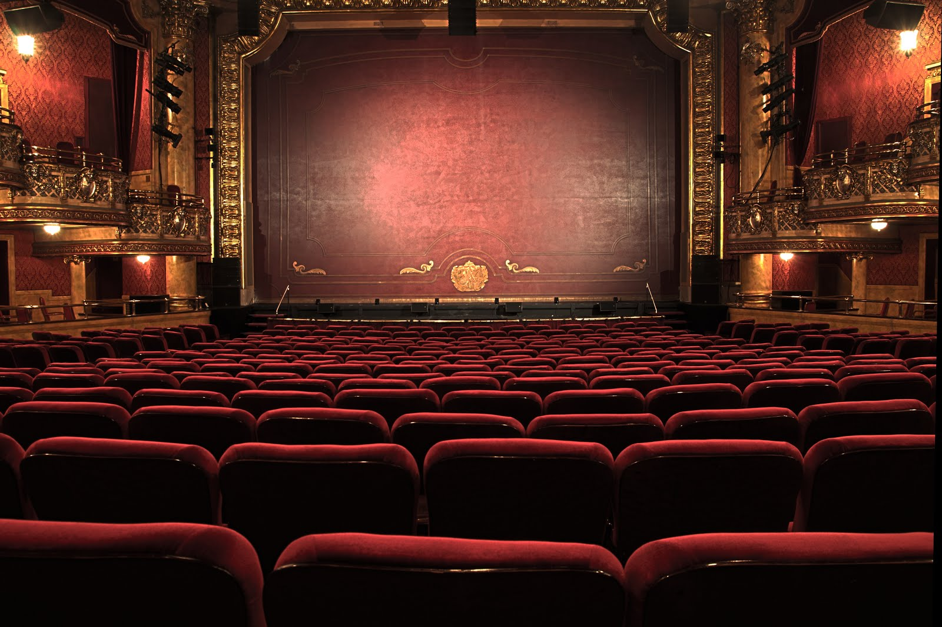
Multiplex Theater Online Booking System

Slide 2
ABSTRACT
Our project basically manages the ticket booking process of a multiplex, providing an interface to the user to book movie tickets in a more easy way. At the front end we have used PHP and at the back end My SQL server. The project proceeds through a sequence of well-designed forms provided with validations to ensure consistency, reliability and most importantly correctness of information fed into the database.

Slide 3
IMPLEMENTATION
The various system tools that have been used in developing both the front end, back end and other tools of the project are being discussed in this chapter.
FRONT END:
HTML, CSS, JAVA SCRIPTS are utilized to implement the frontend.
BACK END
The back end is implemented using MYSQL which is used to design the databases.

Slide 4
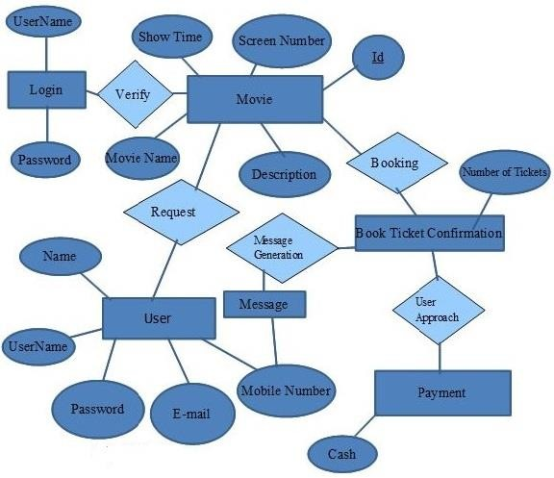
Block Diagram

Slide 5
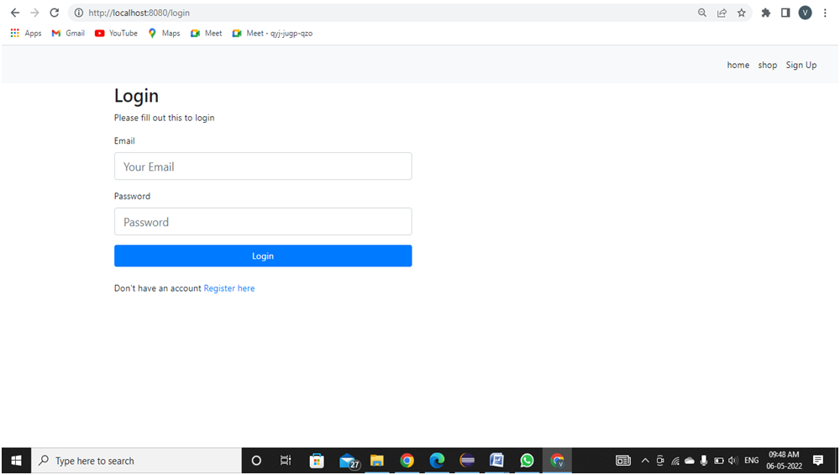
AA-001 All Users logging into the system should be authenticated using a unique login-id and password

Slide 6
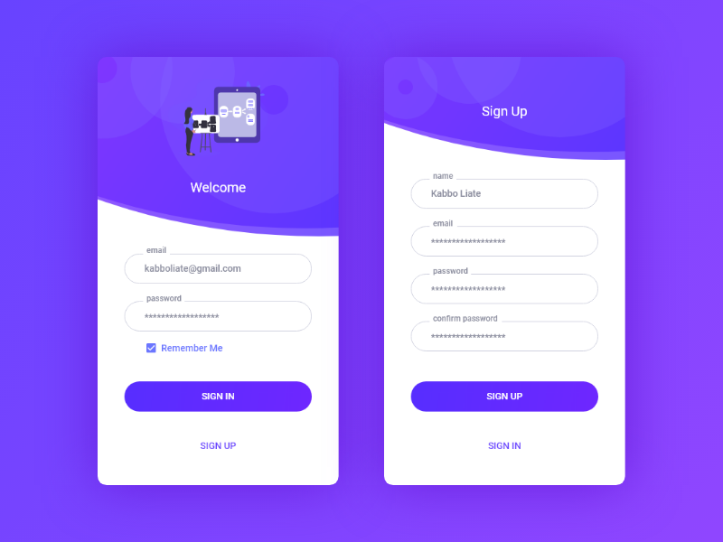
AA-001 All Users register into the system should be authenticated using a unique details.

Slide 7
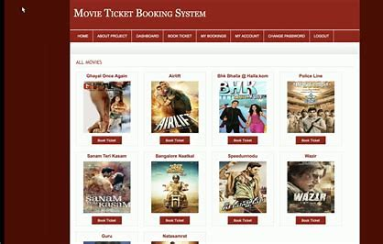
Check Availability
After Login, User, Can Search Movie From Movie List.

Slide 8
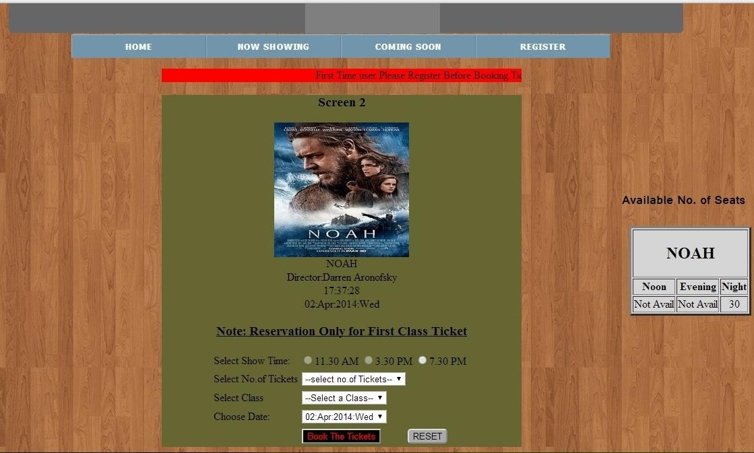
User Can Check Ticket Availability.
User can also check the Movie Running Hours.
If Ticket is Available User Can Book Ticket.

Slide 9
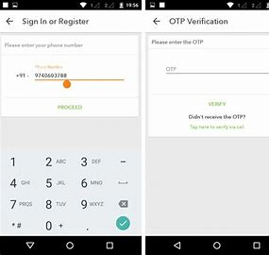
Book Ticket.
User can book ticket by specifying username and Phone Number.
Then Select Number Of Seats to Book.
A conformation Message will be sent to the Given Number. The content of the message is as shown below:-

Slide 10
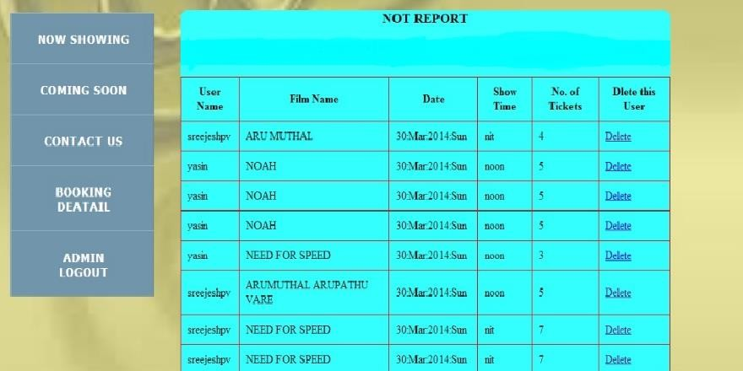
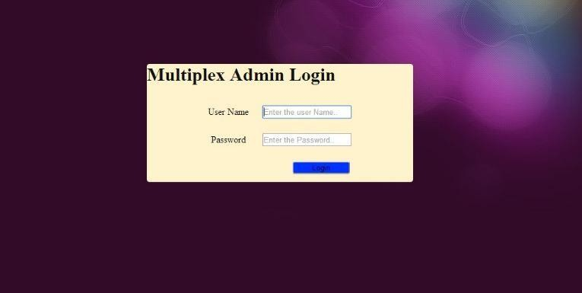
Admission Control

Slide 11
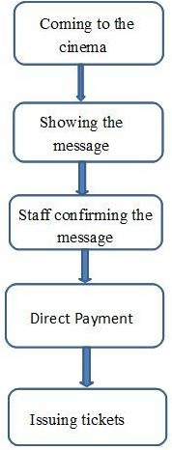
Issuning tickets

Slide 12
Conclusion
Nowadays, traditional reservation ways of cinema ticketing is dying. It’s new age where technology dominates human life. With the software and technological devices, exceptions are reduced and even terminated. Also, people prefer easy, quick and safe way for every part of his life. This project is designed to meet the requirements of a cinema ticket booking system. It has been developed in PHP and the database has been built in My SQL server keeping in mind the specifications of the system.

